Slide 1

Summer Internship: PHP-MVC Framework
An overview of my summer internship, focusing on the PHP-MVC Framework and its application in real-world scenarios at Hardik Traders.

Slide 2

About Me
Name:
Shah Parshva Hardik
Student ID:
23012250210356
Field of Study:
Computer Engineering
Specialization:
PHP-MVC Framework Development
Project Company:
Hardik Traders (HT)

Slide 3

Company Details: Hashtechy
Organization:
Mentor:
Hashtechy
Mr. Vishal Mandora
Contact:
Mentor Email:
+91 85111 90784
VISHAL.M@HASHTECHY.COM
Email:
HR@HASHTECHY.COM
Address:
604, Brooklyn Tower, Beside YMCA Club, Sarkhej - Gandhinagar HWY, Ahmedabad, Gujarat 380015

Slide 4
Introduction to MVC
Architectural Pattern
Component Separation
Codebase Benefits
MVC (Model-View-Controller) is a fundamental software architectural pattern designed to enhance code organization.
It divides an application into three distinct yet interconnected components: Model, View, and Controller.
This separation promotes a clean, scalable, and maintainable codebase, simplifying development and updates.

Slide 5

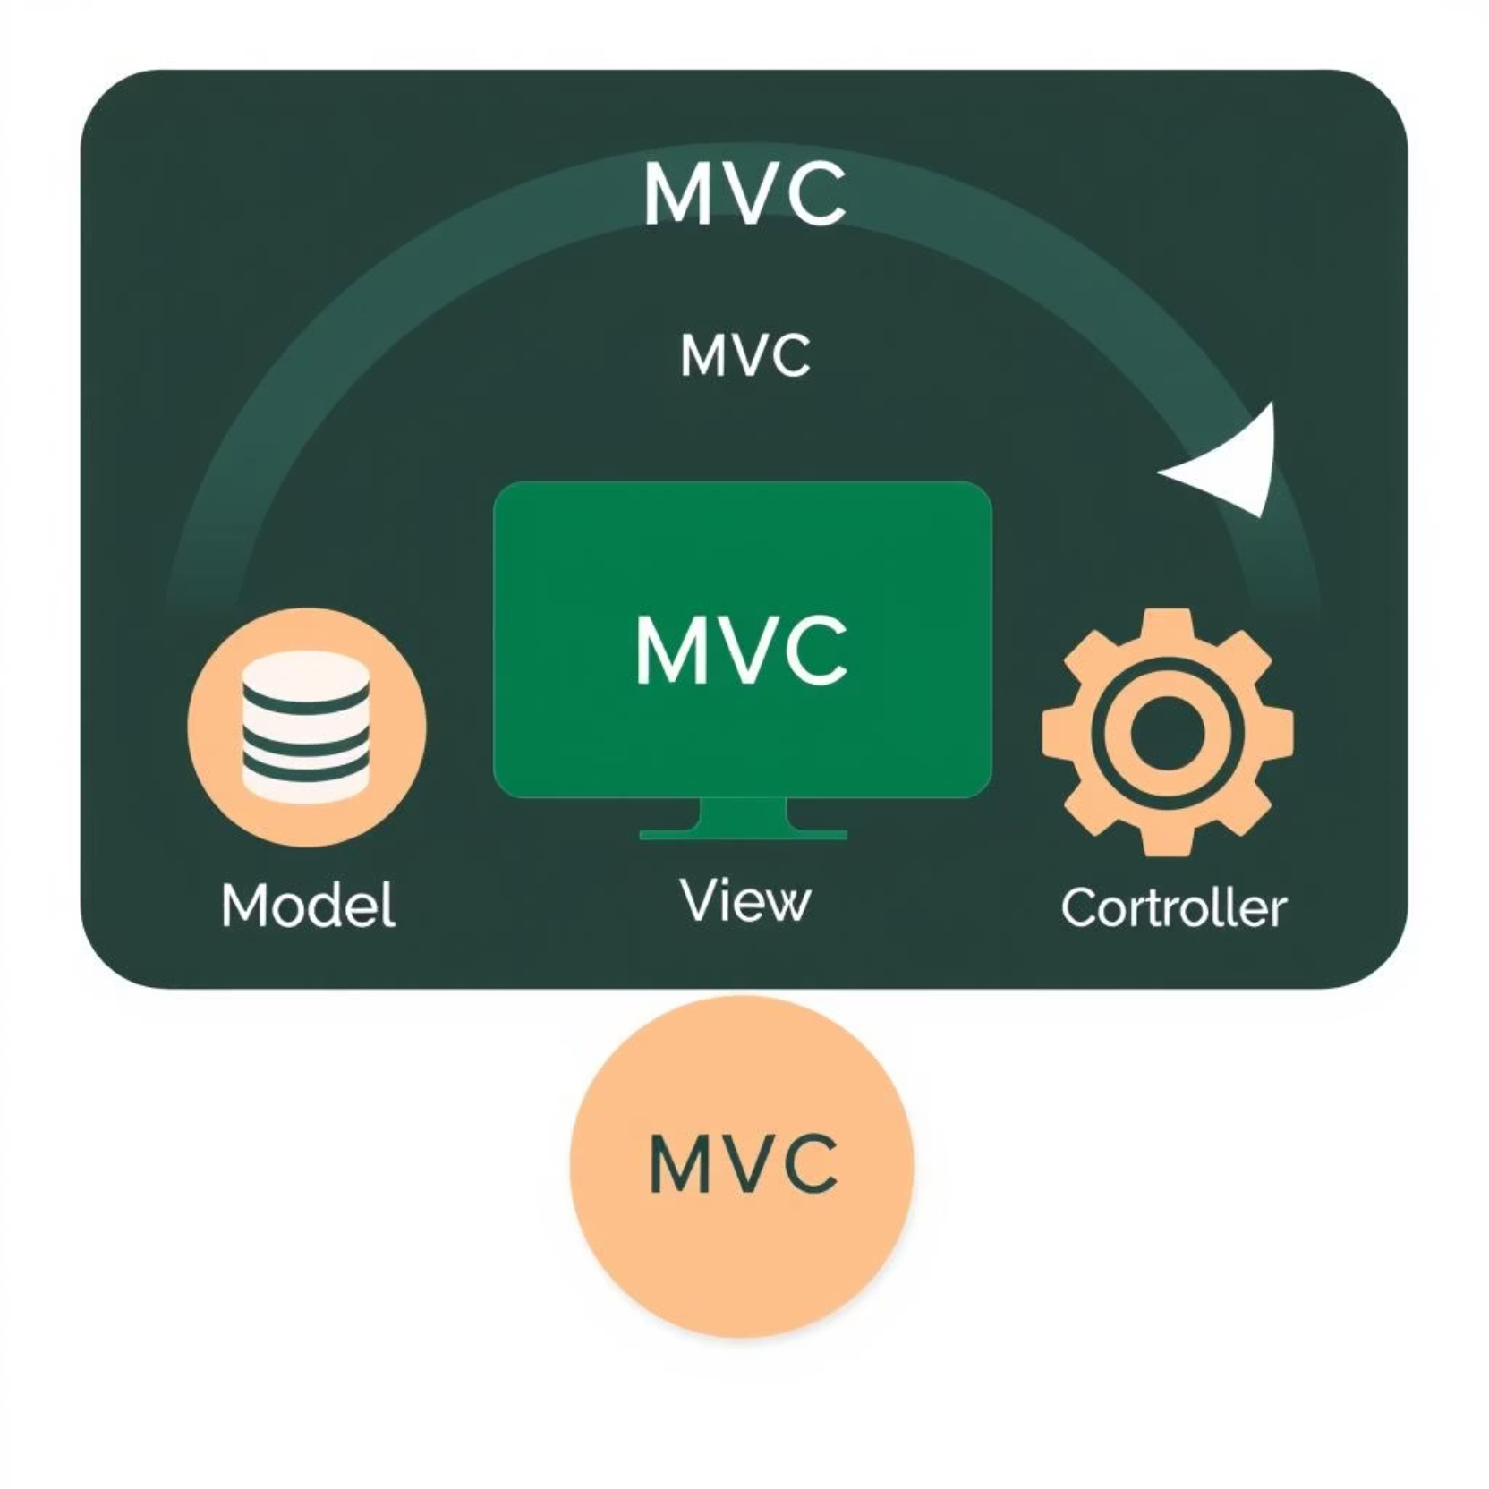


Core Components of MVC
Model
Manages data, business logic, and validation. It ensures data integrity and enforces business rules within the application.
View
Renders the user interface, displaying data provided by the Model. It is responsible for UI presentation and updates.
Controller
Acts as the bridge between Model and View. It processes user input, interacts with the Model, and updates the View.

Slide 6
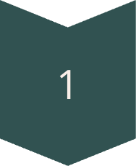

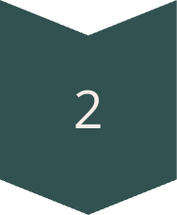

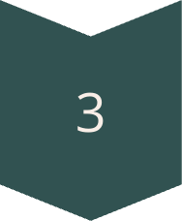
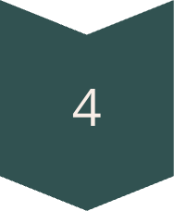


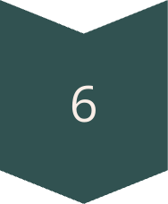

How MVC Works & Its Benefits
MVC Workflow
Key Benefits
User Interaction
User interacts with the View (e.g., clicking a button or submitting a form).
Separation of Concerns
Controller Receives Input
Each component has a defined role, simplifying maintenance and updates.
The Controller captures the input and determines the appropriate action to take.
Model Interaction
Reusability
Controller interacts with the Model to execute necessary actions, like data retrieval.
Components can be effortlessly reused across various application parts.
Model Processing
The Model processes data and returns results to the Controller.
View Update
Flexibility
The Controller then updates the View with the new data.
MVC streamlines component swapping and new feature integration.
UI Render
Finally, the View renders the updated user interface.
Versatile Use Cases
Widely adopted in web, mobile, and desktop applications.

Slide 7
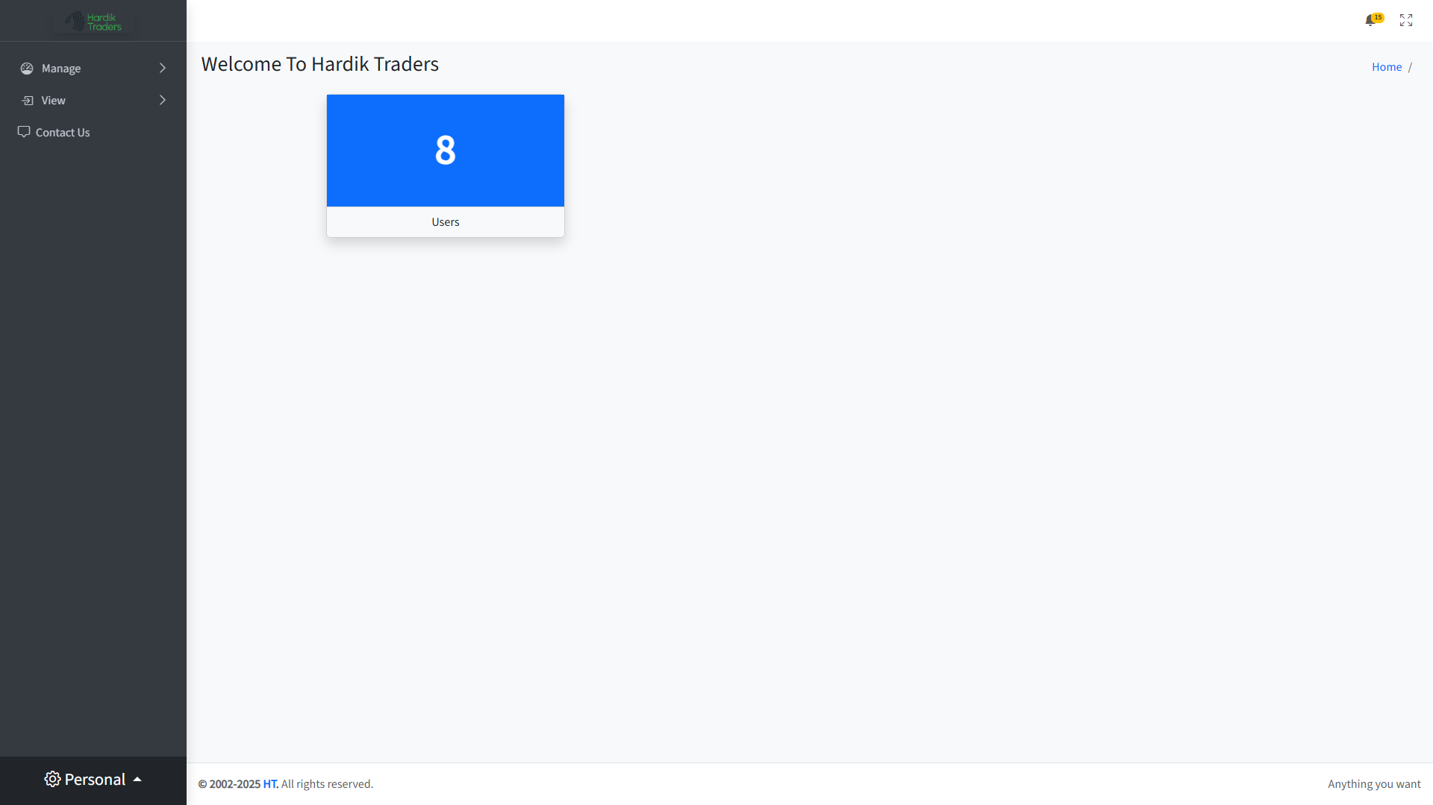
Application Output Showcase

Slide 8
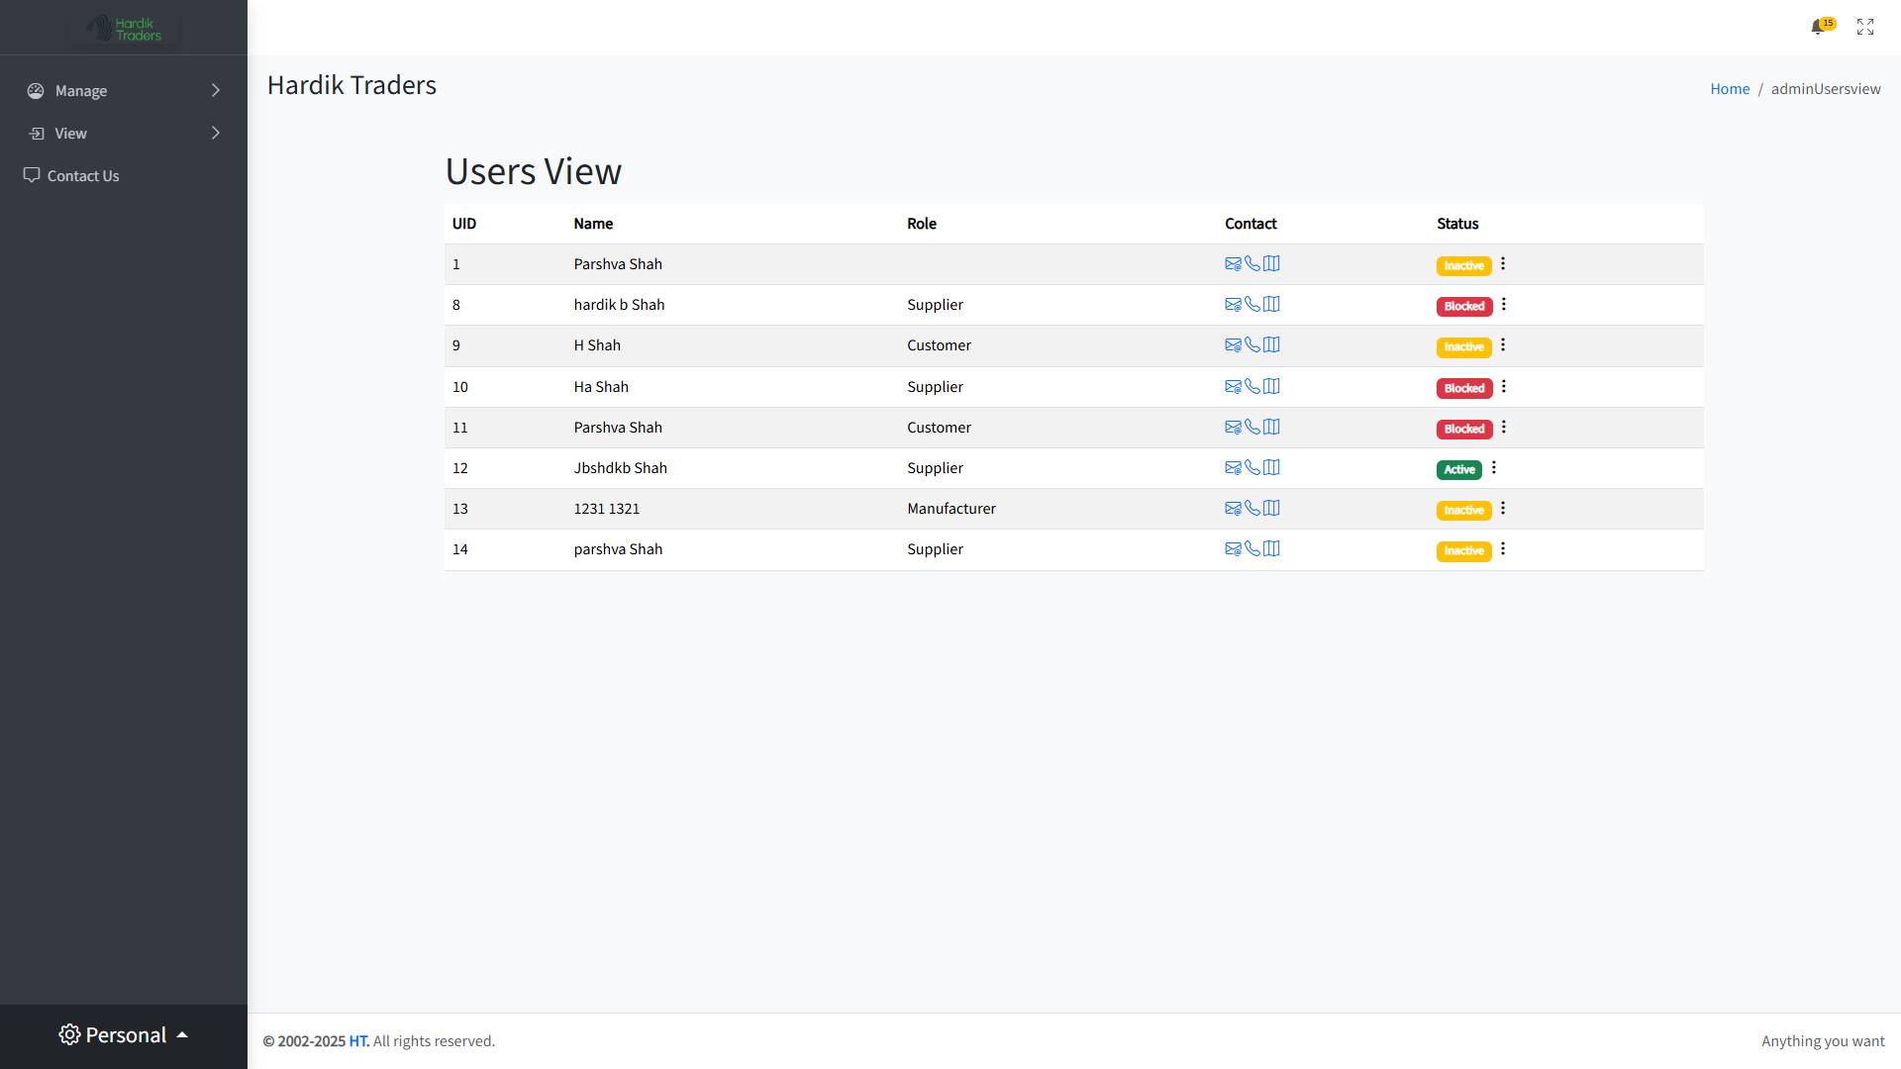
Application Output Showcase

Slide 9
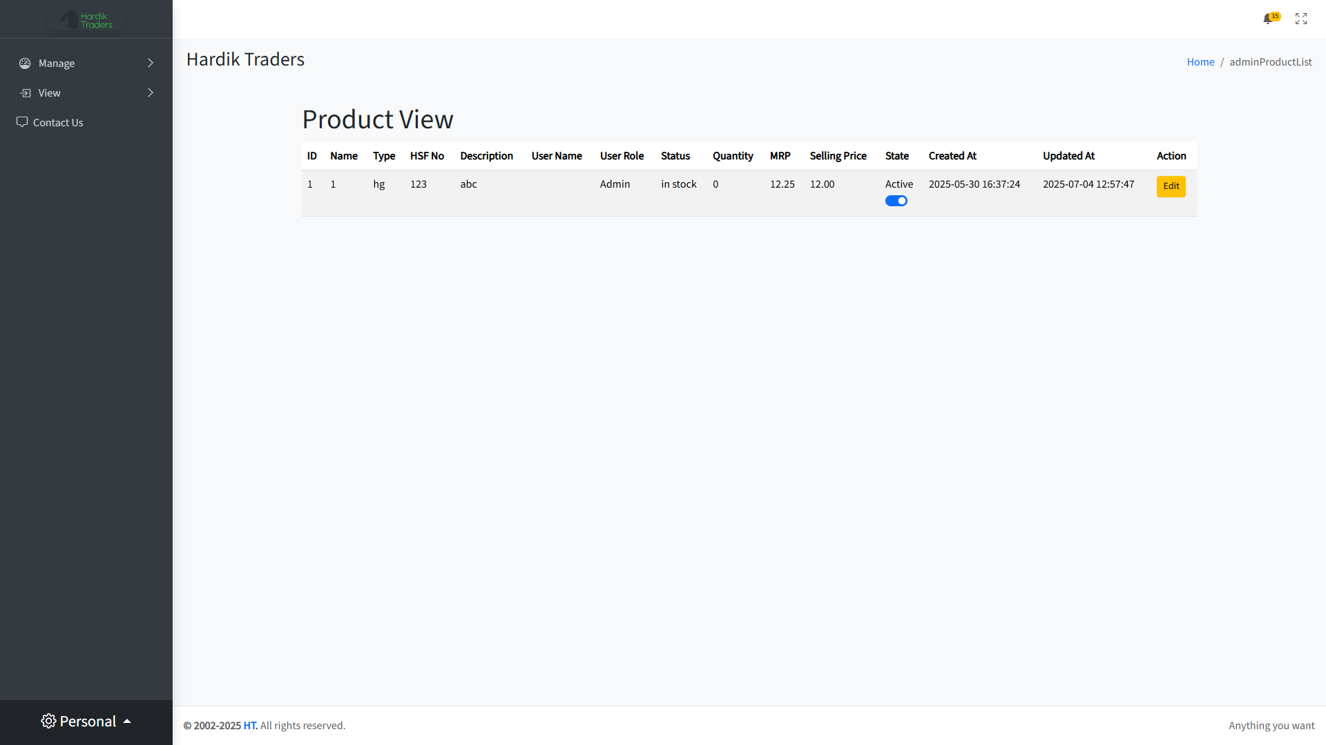
Application Output Showcase

Slide 10
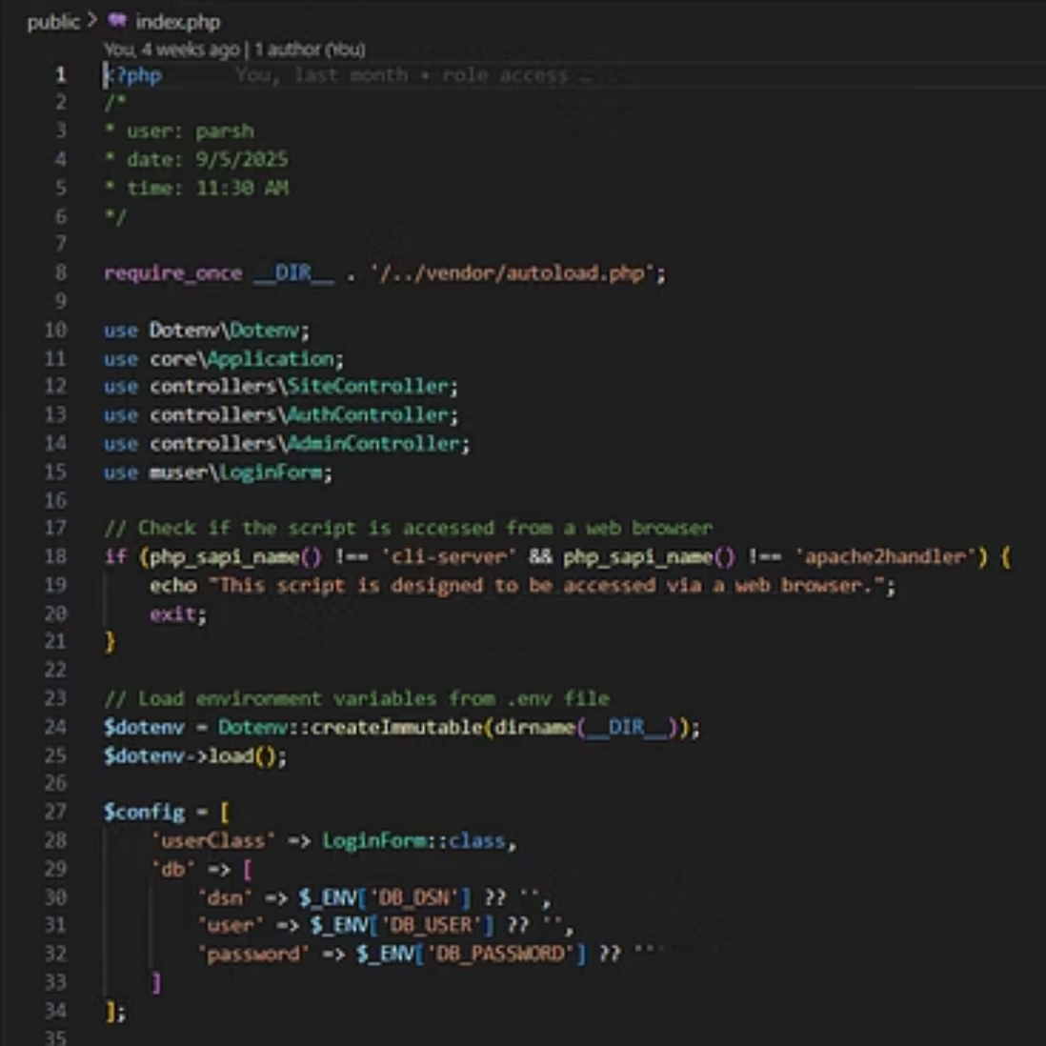
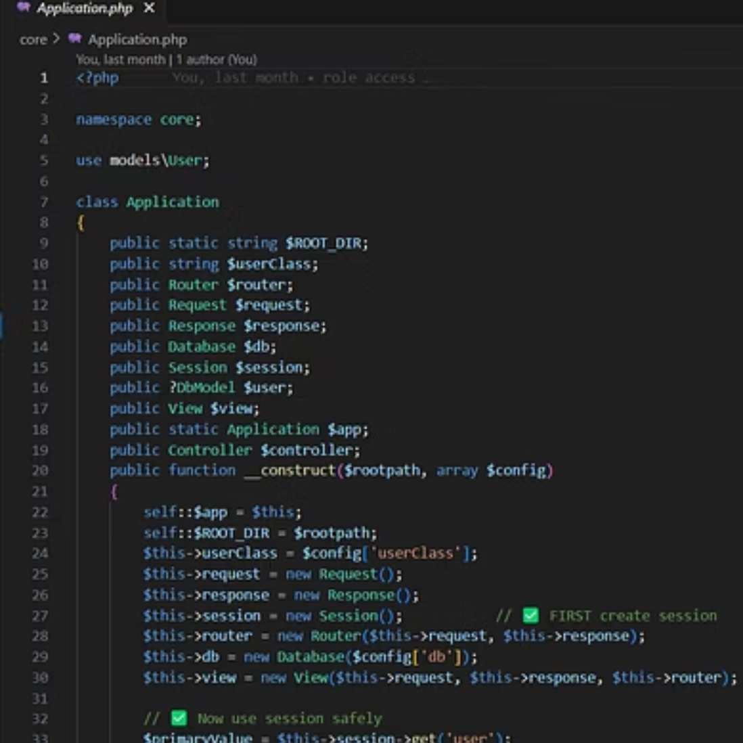
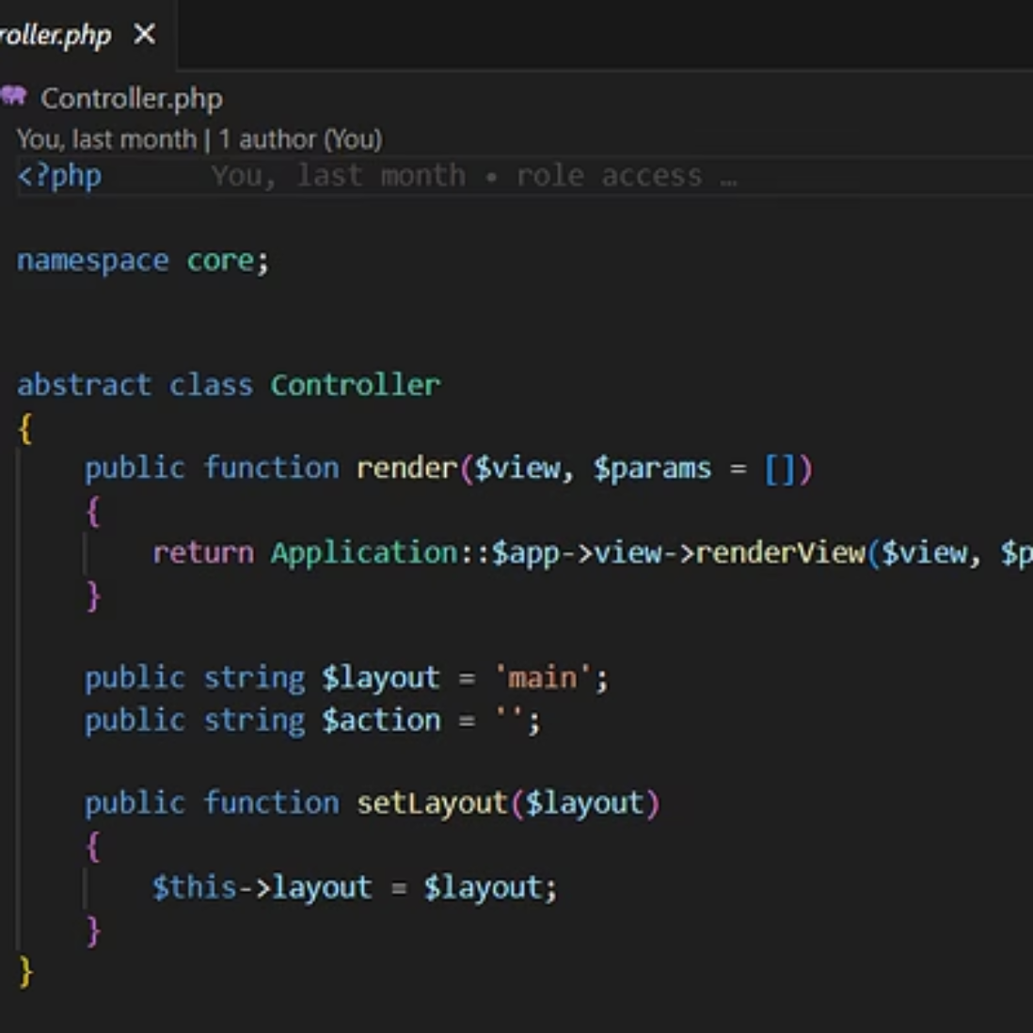
Code Implementation
A glimpse into the codebase, showcasing the structure and logic employed in developing the application with the PHP-MVC framework.

Slide 11
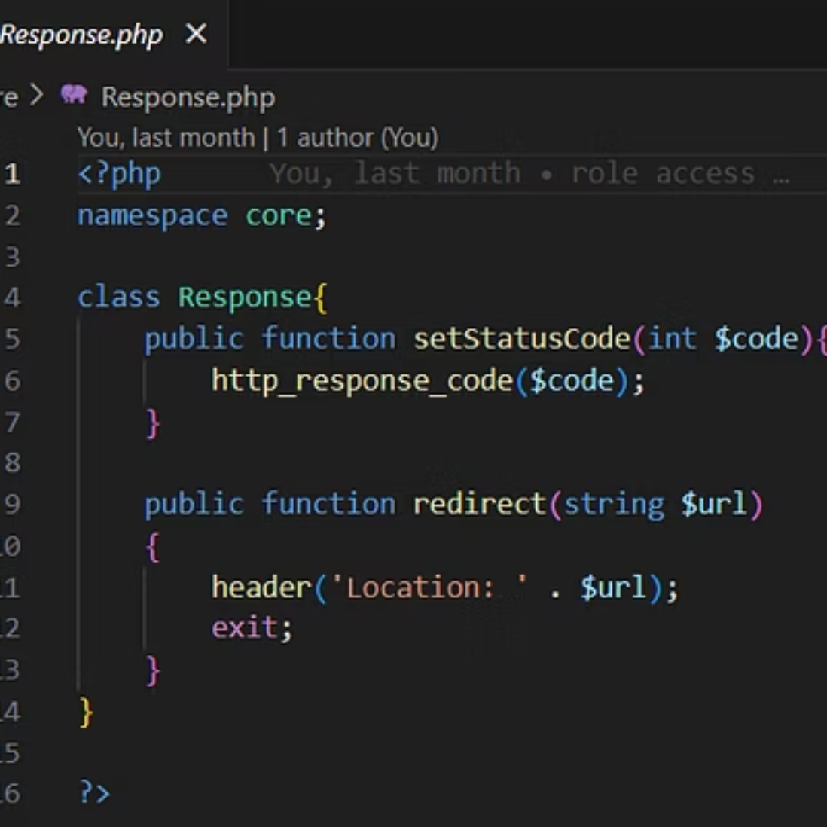
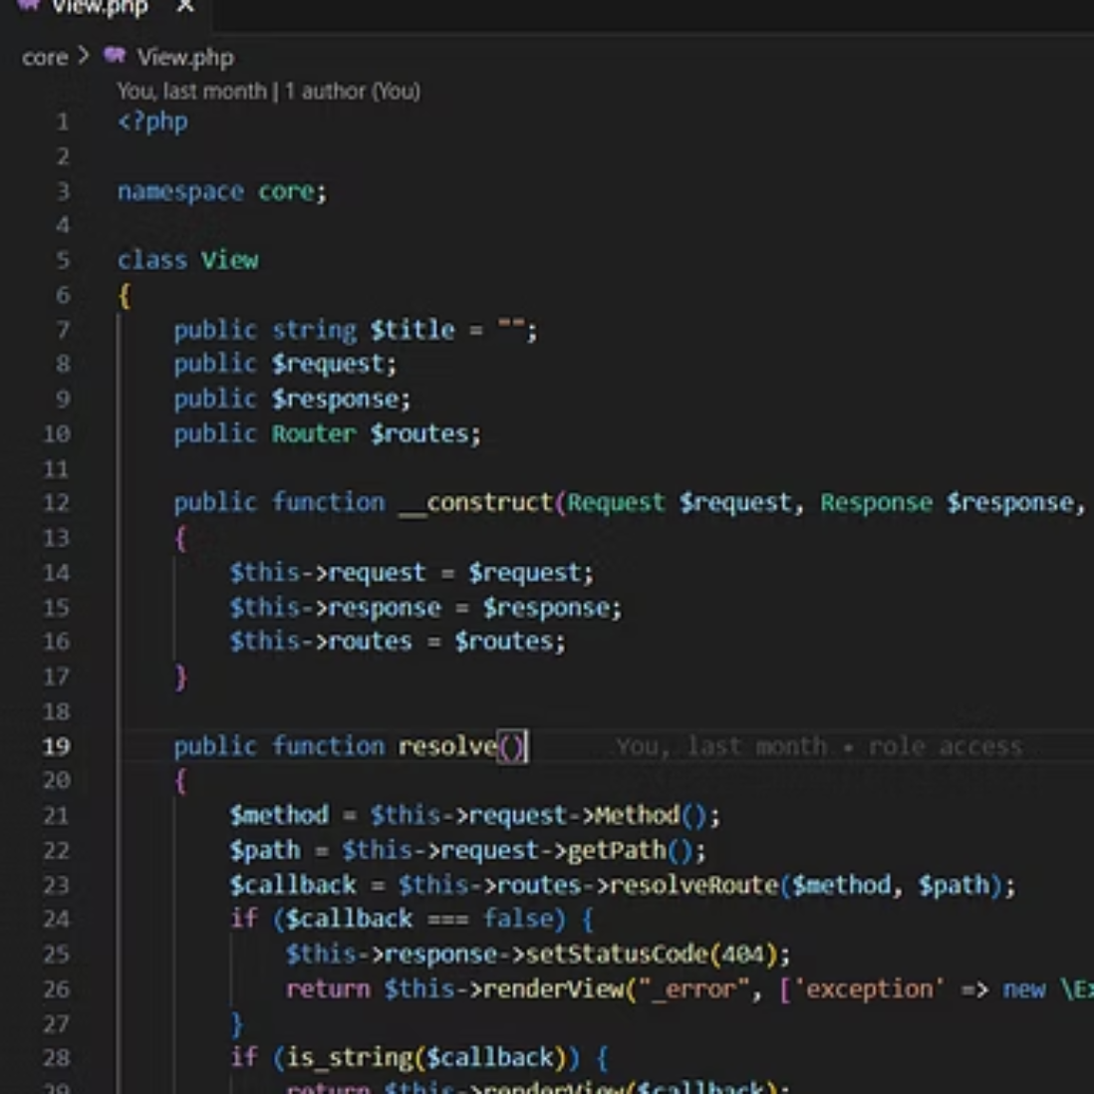
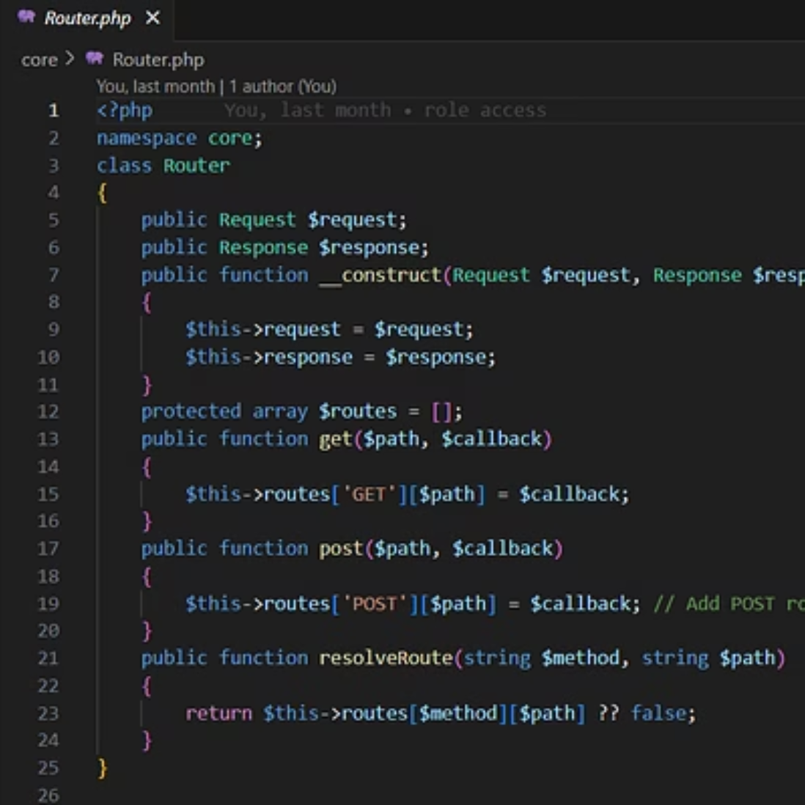
Code Implementation
A glimpse into the codebase, showcasing the structure and logic employed in developing the application with the PHP-MVC framework.

Slide 12

Thank You
Thank you for your time and attention. I am excited to apply my knowledge of the PHP-MVC Framework and continue learning and contributing to the field of computer engineering.

